Slide 1




Detection and identification of a path for camera calibration
B.S.C.S. Franci Suni Lopez

Slide 2
Pipeline
Binarization
Noise filter
Edge detection
Contours detection
Ellipse detection
Clustering

Slide 3
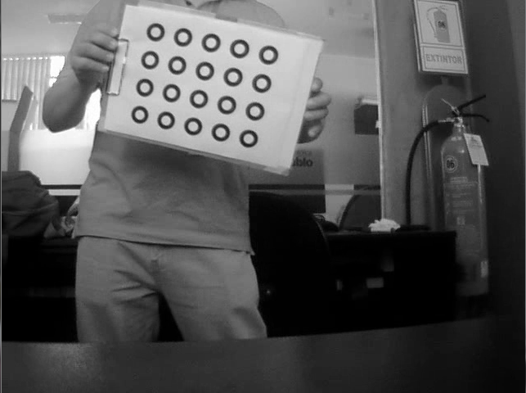

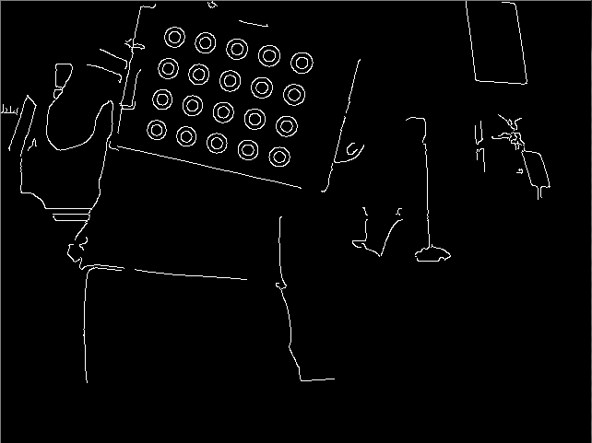
Binarization, noise filter and edge detection
Convert current frame to Gray Scale
Apply a Gaussian BLUR of size 5x5
Canny edge detection
Find contours

Slide 4
Ellipse detection and selection
Delete contours with points < 10
Delete contours d1 or d2 < 4
Delete
d1
d2

Slide 5
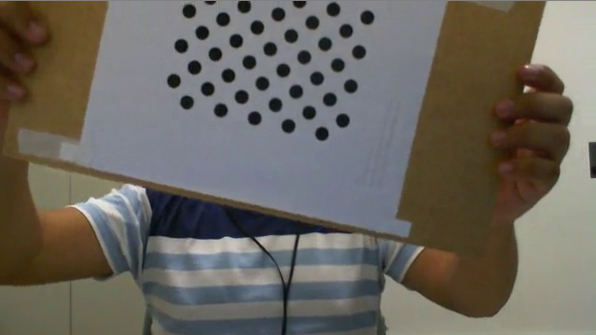
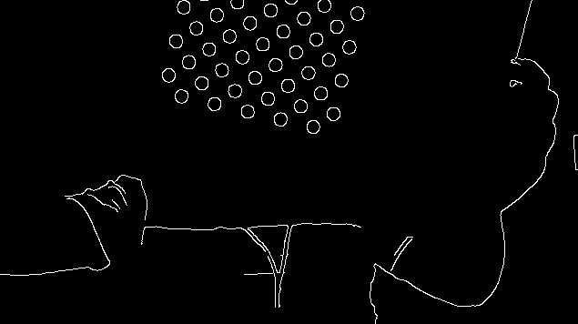
Ellipse detection and selection
Do not recognize path when number of detected ellipses is < number of path rings

Slide 6
Ellipse selection
We select the ellipses where the difference between the contour area and the area of the generated ellipse is <= 2%.

Slide 7
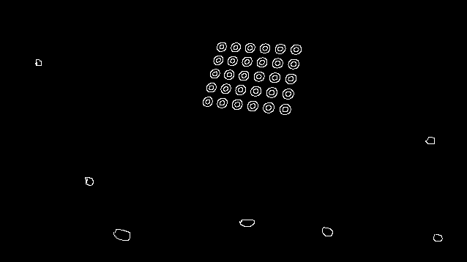
Selection of correct Ellipses
Centroid of ellipses center
Standard deviation of distances
Radio = Average-distance+SD/1.3

Slide 8
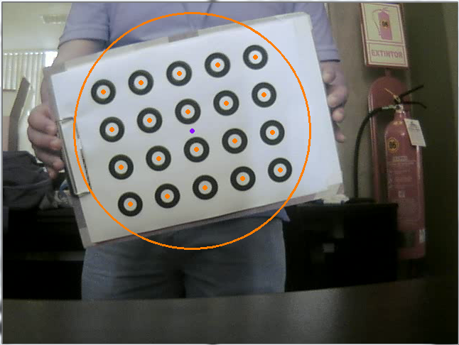
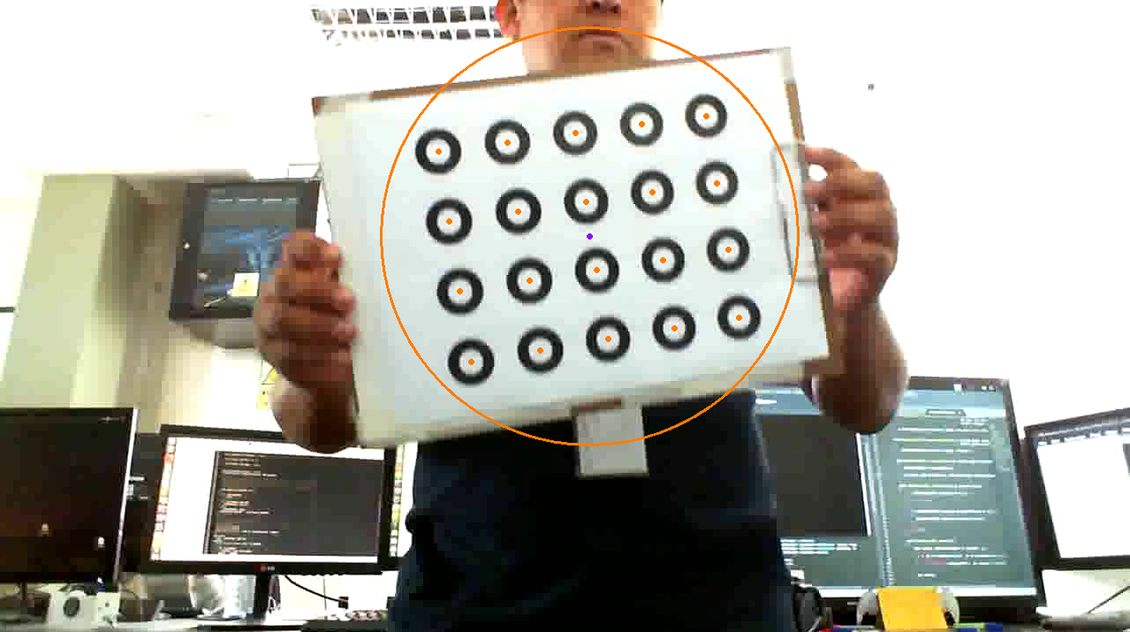
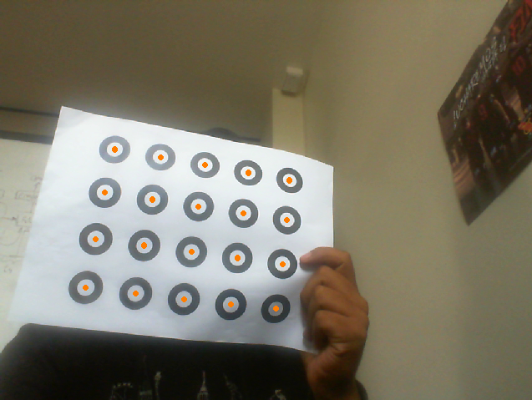
Results

Slide 9
Thanks!
Questions?
Franci Suni Lopez
franci.suni@ucsp.edu.pe

